Slide 1
Human Identification using Humanoid Vision

Slide 2
Current Features
Face finding
Identification
Model capable of finding individual faces
Identifies faces and display their names when detected and recognized
Real Time
Easy Database record
Model is capable of working in real time camera input
Easy method of acquiring dataset required for training

Slide 3
REQUIREMENTS
Python
OpenCV: A strong library used for machine learning
Haar Cascade: Object Detection Algorithm used to identify faces in an image or frames of a video.
LBPH: Recognizer to train data and create metadata.
Numpy: Used for Scientific Computing. Image is stored in a numpy array
OS: For creating/ altering files

Slide 4
ALGORITHMS
HAAR CASCADE
LOCAL BINARY PATTERNS HISTOGRAMS
Haar-like features are digital image features used in object detection.
The haar calculation is done by finding out the difference of the average of the pixel values at the darker region and the average of the pixel values at the lighter region. If the difference is close to 1, then there is an edge detected by the haar feature.
The first computational step of the LBPH is to create an intermediate image that describes the original image in a better way, by highlighting the facial characteristics.
A dataset with the facial images of the people we want to recognize is assigned an ID for each image, so the algorithm will use this information to recognize an input image and give you an output.

Slide 5
Phases
The project has been implemented within three distinct phases:
Face Detection and Data Gathering
Training the Recognizer
Face Recognition

Slide 6
Face Detection and Data Gathering
OpenCV’s Haar cascades is used to find a face in a given frame
Dataset used for face detection consists of frontal face info, and is provided within the OpenCV package
Dataset used to face recognition consists of 200 images of a user’s face

Slide 7

FACE DETECTION AND DATA GATHERING
Face detection
Conversion
Storage
Haar cascade is used to detect any face in the current frame​ from the livestream
Images of the face extracted are then converted to grayscale for easier training
Grayscale images are then stored according to the ID of the user

Slide 8
Training the Recognizer And Face Recognition
LBPH will be used to train the dataset gathered and create a meta-data
Meta-data will be used by LBPH to detect the face Haar cascade identifies

Slide 9
TRAINING THE RECOGNIZER
Read
Conversion
Store
The dataset collected in the previous step is now collected and fed to LBPH trainer
Trainer converts grayscale images into histogram meta-data according to user ID
The meta-data formed​ in a run is stored in a yaml file

Slide 10
FACE RECOGNITION
Face detection
Conversion
Identification
Haar cascade detects any face in the current frame​ from the real time feed
Faces extracted are then converted to grayscale
Grayscale images are compared using meta-data and predicts the user accordingly ​

Slide 11
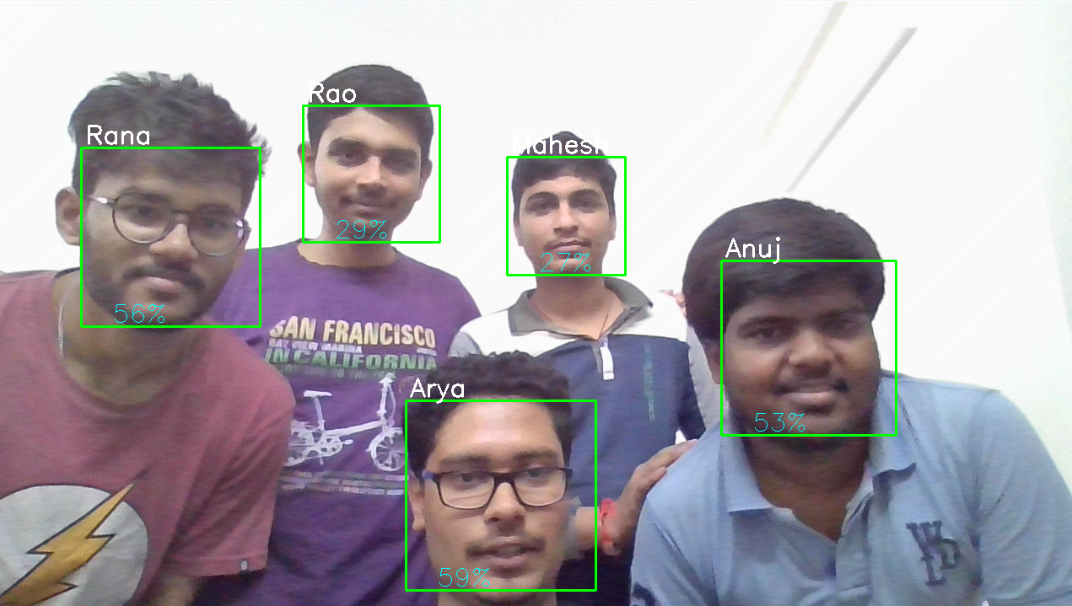

Slide 12
LIMITATIONS
ACCURACY
PERFORMANCE
ANGLES
During testing there were a lot of misidentifications which resulted from issues such as lighting
Increase in data results in more meta-data, resulting in longer processing times
Haar cascade uses frontal face data so it makes detecting side profiles an issue

Slide 13
LITERATURE
DOCUMENTS | IEEE DOI
Machine Learning Based Approach for Person Identification in Group Photos | 10.1109/ICCUBEA.2018.8697683
Weakly and Semi supervised Human Body Part-parsing via Pose-guided Knowledge Transfer | 10.1109/CVPR.2018.00015
Human Object Identification for Human-Robot Interaction by using Fast R-CNN | 10.1109/IRC.2018.00043
Pedestrian detection using quaternion histograms of oriented gradients | 10.1109/ICPICS50287.2020.9202071
LBPH Algorithm for Frontal and Side Profile Face Recognition on GPU | 10.1109/ICSSIT48917.2020.9214228
A real-time face recognition system based on the improved LBPH algorithm | 10.1109/SIPROCESS.2017.8124508
Face Detection Using Haar Cascade in Difference Illumination | 10.1109/ISEMANTIC.2018.8549752
LBPH based improved face recognition at low resolution | 10.1109/ICAIBD.2018.8396183

Slide 14
THANK YOU
Presented by:
Abhay Rao
Abhishek Rana
Abhishek Arya
Anuj S. Kulkarni
Mahesh Parihar

